Slide 1
Creativity, Measurement, and Knowledge Dissemination: Addressing Challenges to Implementing Evidence Based Practices
David Wittenburg
Presented at the 6th Annual Summit
Vocational Rehabilitation Program Evaluation & Quality Assurance Summit
Providence, RI
September 16, 2013

Slide 2
Overview
Challenges to implementing evidence based practices (EBPs)
Addressing challenges
Creativity, measurement, and knowledge translation
Examples
Illustration of concepts
Comparison of fast vs. slow innovations
Recent research applications
VR study on use of EBPs
Youth Transition Demonstration (YTD)

Slide 3
1. Challenges

Slide 4
What is an Evidence-Based Practice?
“Best evidence in making decisions about the care of the individual….Integrating individual expertise with the best available external evidence from systematic research.”
Sackett et al (1996)

Slide 5
Lack of Coordination and Collaboration
Services are “fragmented”
Few examples of local, state, and/or federal agency “early” intervention
Few tests of interventions that change status quo

Slide 6
Challenges to Measuring Efficacy of Programs/Policies with Current Measures
Cannot rigorously measure outcomes of interest
Some outcomes not reliably tracked
Lack of information on comparison or control group
Difficulty measuring long-term impacts
Notes:
Livermore and Goodman (2009)

Slide 7
Example of Research Challenges: EBPs Use in VR Agencies
Survey of 355 staff in 3 state VR agencies
Identify barriers and facilitators to using EBPs
Source: Graham et al. (2013)

Slide 8
Findings: EBPs Use in VR Agencies
Strong Demand
84% valued research for practice
Limited use
48% reported their agency used practices
Barriers
EBPs not necessarily the expectation
Inadequate time for VR staff to find or use resources
Inconsistency in coordinating resources
Source: Graham et al. (2013)

Slide 9
2. Addressing the Challenges

Slide 10
Creativity
“We assume that technical problems can be solved only by people with technical expertise…but the assumption is wrong…. It is not until the challenge is shared with motivated outsiders that the solution can be found.” (Jonah Lehrer, Imagine: How Creativity Works)

Slide 11
Measurement
“If you can not measure it, you can not improve it.” (Lord Kelvin)

Slide 12
Knowledge Dissemination
“Successful applied scientists develop a feel for decision making process….Crucially, they repackage their logic-laced messages to impress their ideas upon those who are more comfortable with intuition or emotion than with evidence.” (Kaiser Fung, from Numbers Rule Your World)

Slide 13
3. Examples

Slide 14
Illustration of Concepts: Anesthesia vs. Antisepsis
Basic question: How do you speed innovation?
Compared Anesthesia vs. Antisepsis
Anesthesia: gas through an inhaler to alleviate pain
Antisepsis: eliminating sources of infection (e.g., washing hands, clothes)
Gawande (2013)

Slide 15
Both Approaches Were Creative
Anesthesia: easily administered through a gas
Antisepsis: use carbolic acid to cleanse hands/wounds

Slide 16
Both Methods Had Strong Measures and Were Disseminated
Anesthesia: 1846 Boston Medical Journal published findings showing the use in patients
Word spread through letters, meetings, and periodicals
Antisepsis: 1867 published findings in The Lancet showing substantial reduction in deaths among patients

Slide 17
Acceptance of Knowledge Dissemination Differed
Anesthesia innovation spread quickly, whereas antisepsis stalled
Why?
Anesthesia: Addressed an observable issue (pain) that lessened the burden on all
Antisepsis: Germs were invisible and carbolic acid burned the hands of clinicians

Slide 18
Application #1: VR Program Management Study
Study from RTAC on Program Management
Goal: Identify promising approaches
Case studies in 8 state VR agencies
States selected as “high performers” by peers
Foley 2013

Slide 19
Common Threads Among Top Performers
Leadership and mission driven
Strong mission driven but most saw strategic planning could take us off mission very fast
Efforts on retention and succession planning
Strong interest in making things work better
Developing program improvement/evaluation
Data-driven leadership
Management regarded its own frontline staff as most important; valued communication

Slide 20
Application #2: Youth Transition Demonstration (YTD)
Transition-age youth (ages 14 to 25) on SSI or at risk of becoming SSI-eligible
Many at-risk for poor adult outcomes
Random assignment design in six sites
Interventions differed by site
Fraker et al. (2012)

Slide 21
Youth Works Overview
Youth Works is one of six YTD projects
Operated by Human Resource Development Foundation (HRDF) throughout the state
455 treatment cases (397 control cases)
Operated in 19 counties in West Virginia

Slide 22
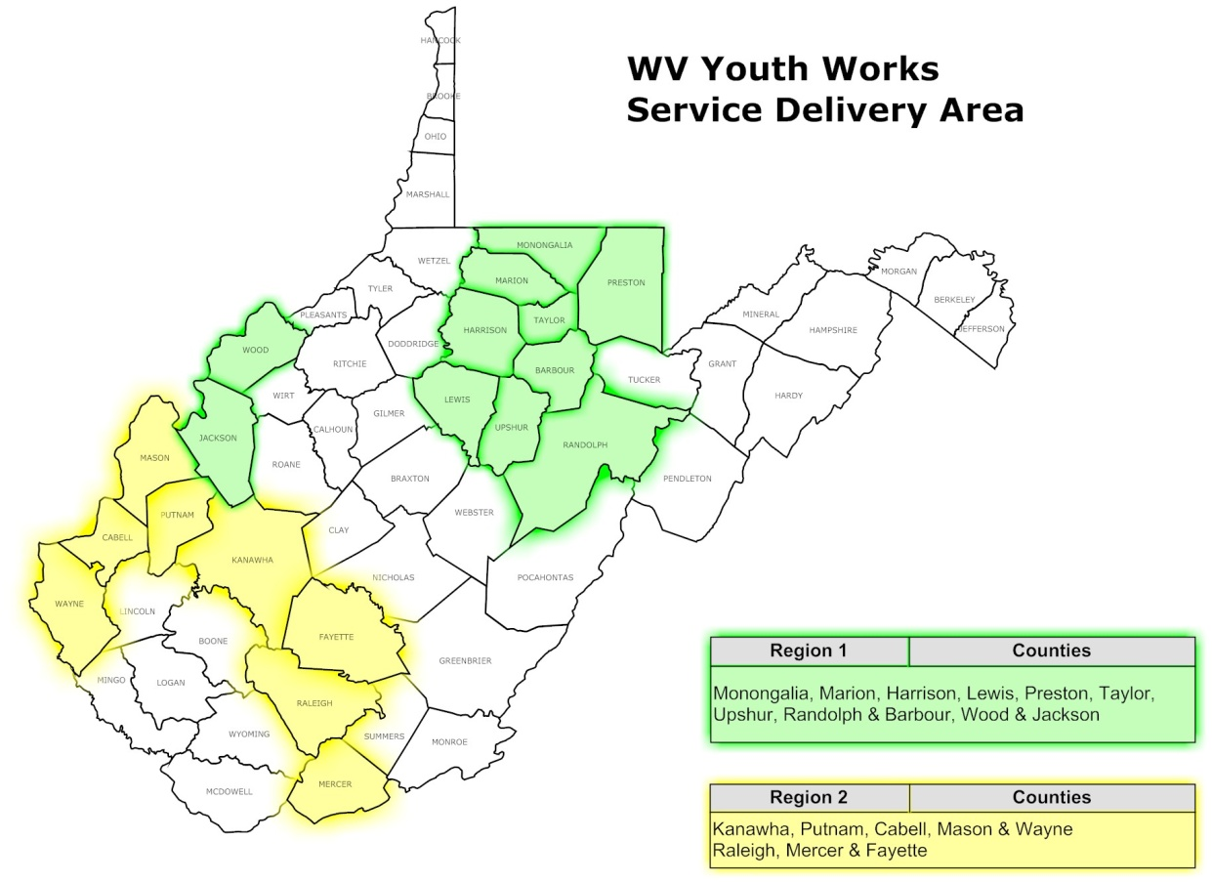
Youth Works Service Delivery Areas
Notes:
The Youth Works served 19 counties in West Virginia. The project covered two regions. Region was in the north and Region 2 was in the south. Region 1 included: Monongalia, Marion, Harrison, Lewis, Taylor, Upshur, Barbour, Preston, Randolph, Wood, and Jackson counties. Region 2 included: Kanawha, Putnam, Cabell, Mason, Wayne, Raleigh, Mercer, and Fayette counties

Slide 23
West Virginia Youth Works Program: Start up
Program built from scratch
HRDF had extensive employment service experience
But, very limited disability service experience

Slide 24
Youth Works Staff Were Creative
Staff flexibility to implement creative approaches
Met youth at homes, school, workplace
Customized supports to youth’s goals

Slide 25
Examples of Creativity in Finding Job Placements
Emphasized benefits to youth and employers of work
Success stories found jobs customized to meet their interests
Types of placements varied: restaurants, veterinary clinic, child care, and even…a Zumba placement.

Slide 26
Strong Emphasis on Measurement
Monthly reports tracked goals
Outcome focused: hours, employment placements
Aggregate and individual goals
Reinforced purpose of project (focus on employment)
Guide technical assistance
Monitor progress

Slide 27
Knowledge Dissemination Reinforced Project Goals
Youth Works staff understood goals
Receptive to technical assistance
Performance measures they developed
Bought into those goals based on evidence
Youth Work participants understood goals
Goals reinforced in orientation materials
Meetings
Messages to parents and youth

Slide 28
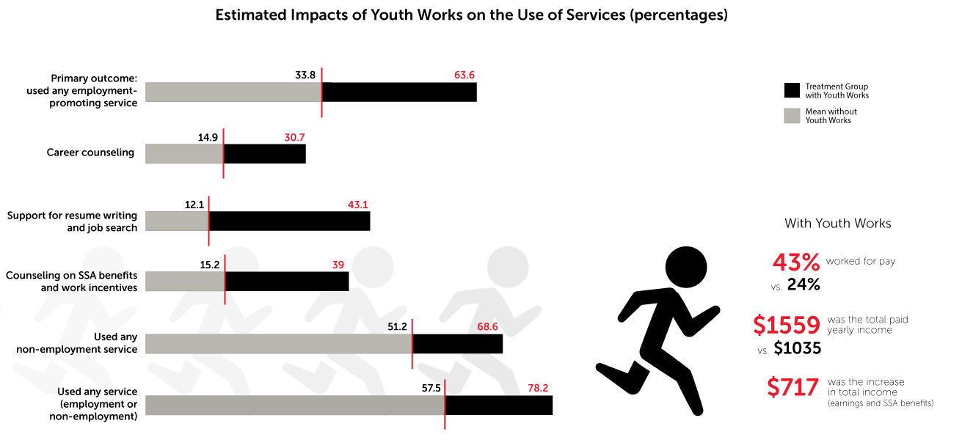
Measuring Impacts: Promising First Year Findings
Notes:
Alt text: Youth Works increased the use of employment-promoting services by youth with disabilities. Nearly two-thirds of treatment group youth reported having used any employment-promoting service in the year following random assignment. We estimated that, in the absence of the project, only one-third of these youth would have used any such service. Thus, the impact of Youth Works was a 30 percentage point increase in the use of employment-promoting services. This overall impact was a product of impacts on the use of a number of specific types of employment services. The largest of these impacts were on support for resume writing and job search activities (31 percentage points), benefits counseling (24 percentage points), and career counseling (16 percentage points).
Youth Works also increased participation in non-employment services, such as discussions about the youth’s interests and plans for the future, by 17 percentage points (Table ES.1). Considering all types of services, 78 percent of treatment group members reported having used any employment or non-employment service. In the absence of Youth Works, we estimated that 58 percent of them would have used any service. Youth Works thus increased the share of youth using any service by 21 percentage points.
Youth Works sought to improve economic self-sufficiency and independence among youth receiving SSA disability benefits by providing employment-promoting services, such as job-search assistance, and enhanced SSA work incentives.
Our primary outcome in the domain of paid employment was whether a youth was ever employed in a paid job during the year following random assignment. We found that 43 percent of treatment group youth worked for pay at some time during the year, whereas we estimated that only 24 percent would have done so in the absence of Youth Works. The estimated impact of 19 percentage points is statistically significant. We also estimated the project’s impact on earnings, a supplementary outcome of considerable policy interest in this domain. We found that Youth Works increased earnings by about 50 percent; treatment group youth earned an average of $1,559 in the year following random assignment, whereas we estimated that they would have earned just $1,035 if they had not had the opportunity to participate in Youth Works.
In the domain of youth income, we found that Youth Works had a positive impact on the primary outcome: total youth income from earnings and SSA benefits (combined) during the year following random assignment. The impact of $717 per year represents an increase of ten percent over the income that treatment group youth would have received if they had not had the opportunity to participate in Youth Works.

Slide 29
Summary
Creativity
Measurement
Knowledge dissemination
Messaging must consider all entities
May need to be reinforced
Customization matters (“people talking to people”)

Slide 30
Contact Information
David Wittenburg
Center for Studying Disability Policy
Mathematica Policy Research
P.O. Box 2393
Princeton, NJ 08543-2393
dwittenburg@mathematica-mpr.com
http://www.DisabilityPolicyResearch.org

Slide 31
References
Fraker, Thomas M., Arif A. Mamun, Michelle S. Manno, John Martinez, Deborah Reed, Allison Thompkins, and David C. Wittenburg. “The Social Security Administration's Youth Transition Demonstration Projects: Interim Report on West Virginia Youth Works. Final Report.” Submitted to the Social Security Administration, Office of Program Development and Research. Washington, DC: Mathematica Policy Research, December 2012.
Fung, Kaiser. Numbers Rule Your World: The Hidden Influence of Probabilities and Statistics on Everything You do. McGraw-Hill, 2010.
Gawande, Atul. Slow Ideas: Some Innovations Spread Fast. how do You Speed the Ones that Don’t? available at http://www.newyorker.com/reporting/2013/07/29/130729fa_fact_gawande (accessed September 5, 2013).
Graham, Carolyn, Katherine Inge, Paul Wehman, Kathleen Murphy, William G. Revell, and Michael West. “Moving Employment Research into Practice: Knowledge and Application of Evidence-Based Practices by State Vocational Rehabilitation Agency Staff.” Journal of Vocational Rehabilitation, vol. 39, no. 1, 2013, pp. 75-81.
Lehrer, Jonah. Imagine: How Creativity Works. Houghton Mifflin Harcourt, 2012.
Sackett, David L., William M. Rosenberg, JA Gray, R. B. Haynes, and W. S. Richardson. “Evidence Based Medicine: What it is and what it Isn't.” BMJ: British Medical Journal, vol. 312, no. 7023, 1996, pp. 71.

